Slide 1
What is classless addressing?
Classless addressing is an IPv4 addressing architecture that uses variable-length subnet masking.
Classless Addressing
To reduce the wastage of IP addresses in a block, we use sub-netting. What we do is that we use host id bits as net id bits of a classful IP address. We give the IP address and define the number of bits for mask along with it (usually followed by a ‘/’ symbol), like, 192.168.1.1/28. Here, subnet mask is found by putting the given number of bits out of 32 as 1, like, in the given address, we need to put 28 out of 32 bits as 1 and the rest as 0, and so, the subnet mask would be 255.255.255.240.

Slide 2

Note
The first address in the block can be found by setting the rightmost 32 − n bits to 0s.
19.2

Slide 3
A block of addresses is granted to a small organization. We know that one of the addresses is 205.16.37.39/28. What is the first address in the block?
Example 19.6
Solution
The binary representation of the given address is 11001101 00010000 00100101 00100111
If we set 32−28 rightmost bits to 0, we get
11001101 00010000 00100101 0010000
or 205.16.37.32.
This is actually the block shown in Figure 19.3.
19.3

Slide 4
Note
The last address in the block can be found by setting the rightmost 32 − n bits to 1s.
19.4

Slide 5
Find the last address for the block in Example 19.6.
Example 19.7
Solution
The binary representation of the given address is 11001101 00010000 00100101 00100111
If we set 32 − 28 rightmost bits to 1, we get 11001101 00010000 00100101 00101111
or 205.16.37.47
This is actually the block shown in Figure 19.3.
19.5

Slide 6
Note
The number of addresses in the block can be found by using the formula ₂32−n.
19.6

Slide 7
Find the number of addresses in Example 19.6.
Example 19.8
Solution
The value of n is 28, of addresses is 2 ³²⁻²⁸ or 16.
which
means
that
number
19.7

Slide 8



Another way to find the first address, the last address, and
Example 19.9
the number of addresses is to represent the mask as a 32-bit binary (or 8-digit hexadecimal) number. This is particularly useful when we are writing a program to find these pieces of information. In Example 19.5 the /28 can be represented as
11111111 11111111 11111111 11110000
(twenty-eight 1s and four 0s).
Find
The first address
The last address
The number of addresses.
19.8

Slide 9
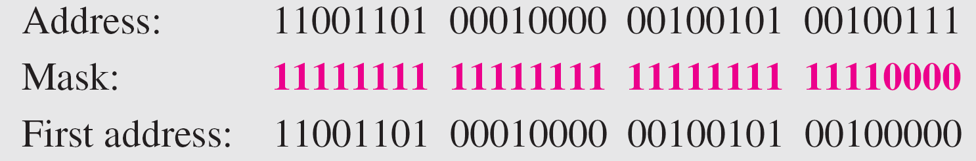
Solution
Example 19.9 (continued)
a. The first address can be found by ANDing the given addresses with the mask. ANDing here is done bit by bit. The result of ANDing 2 bits is 1 if both bits are 1s; the result is 0 otherwise.

Slide 10
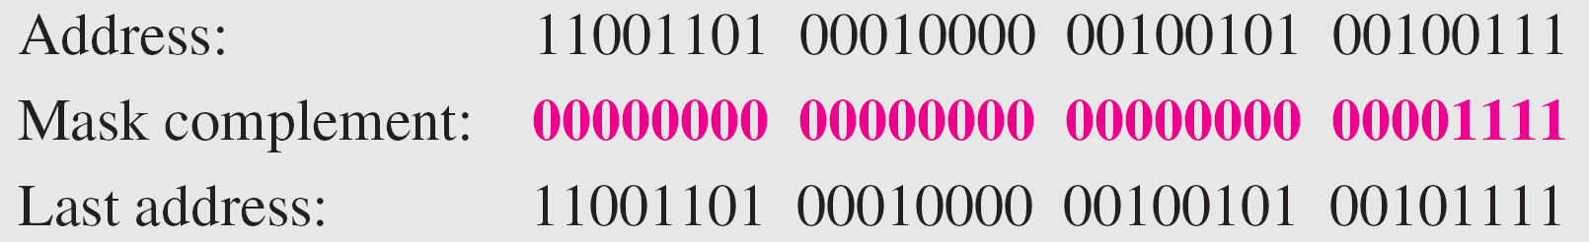
Example 19.9 (continued)
b. The last address can be found by ORing the given addresses with the complement of the mask. ORing here is done bit by bit. The result of ORing 2 bits is 0 if both bits are 0s; the result is 1 otherwise. The complement of a number is found by changing each 1 to 0 and each 0 to 1.

Slide 11
c. The number
Example 19.9 (continued)
of addresses can be found by
complementing the mask, interpreting it as a number, and adding 1 to it.
decimal

Slide 12
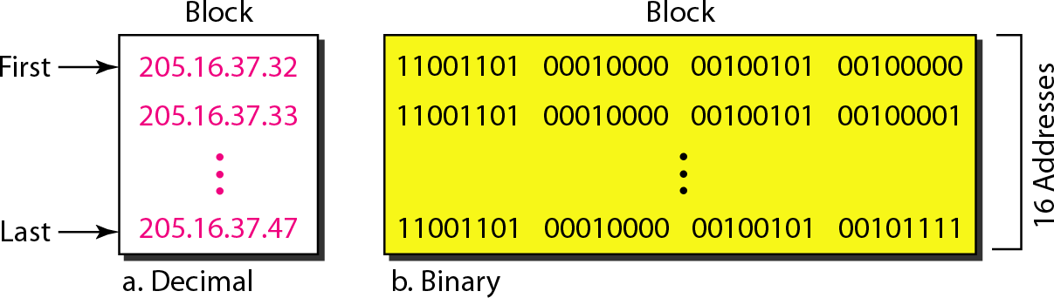
Figure 19.4 A network configuration for the block 205.16.37.32/28

Slide 13
Note
The first address in a block is normally not assigned to any device;
it is used as the network address that represents the organization
to the rest of the world.

Slide 14
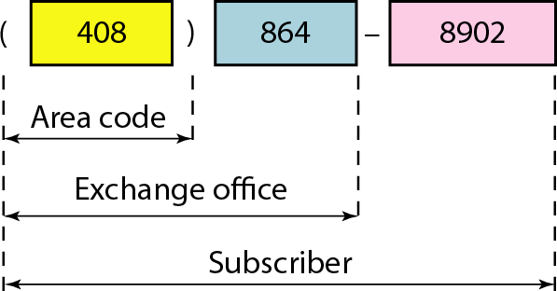
Figure 19.5 Two levels of hierarchy in an IPv4 address

Slide 15
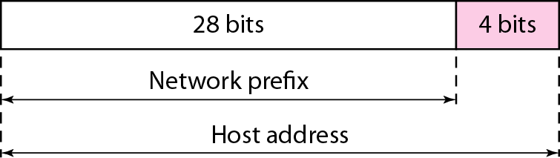
Figure 19.6 A frame in a character-oriented protocol

Slide 16
Note
Each address in the block can be considered as a two-level hierarchical structure:
the leftmost n bits (prefix) define the network;
the rightmost 32 − n bits define
the host.

Slide 17
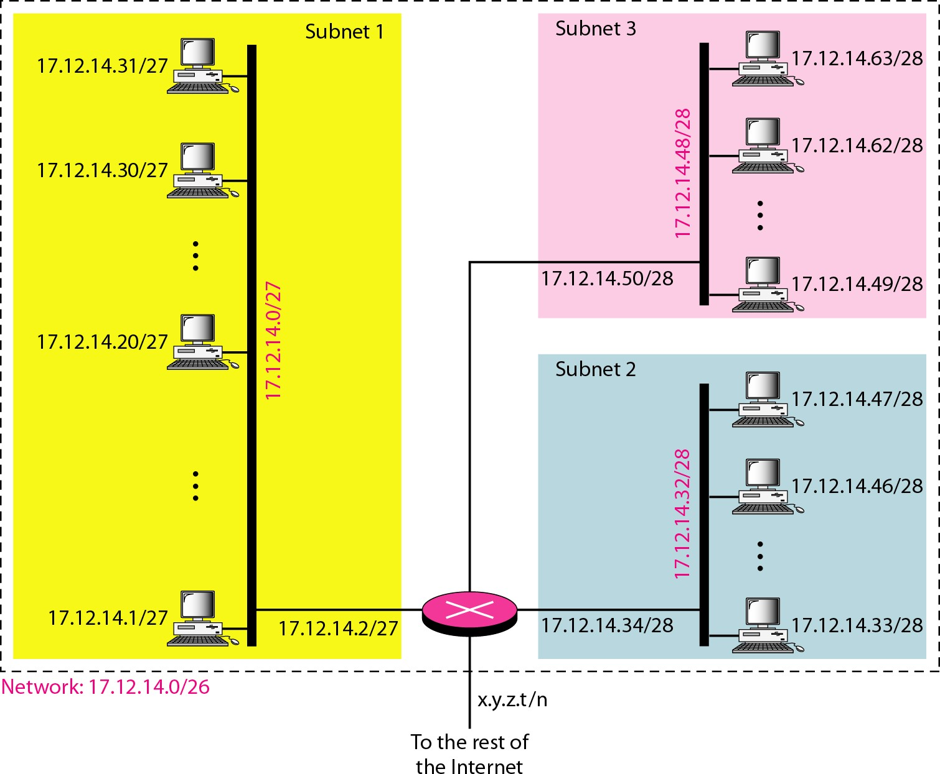
Figure 19.7 Configuration and addresses in a subnetted network

Slide 18
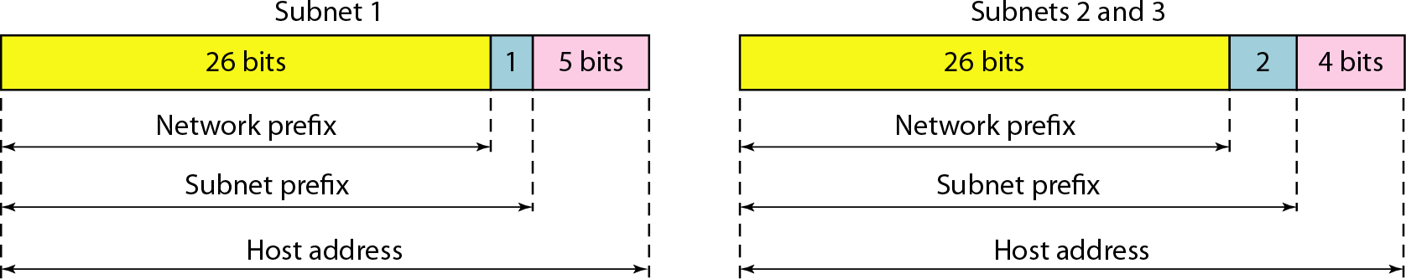
Figure 19.8 Three-level hierarchy in an IPv4 address

Slide 19
Example 19.10
An ISP is granted a block of addresses starting with 190.100.0.0/16 (65,536 addresses). The ISP needs to distribute these addresses to three groups of customers as follows:
The first group has 64 customers; each needs 256 addresses.
The second group has 128 customers; each needs 128 addresses.
The third group has 128 customers; each needs 64 addresses.
Design the subblocks and find out how many addresses are still available after these allocations.

Slide 20
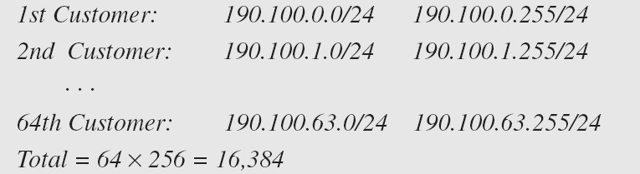
Solution
Figure 19.9 shows the situation.
Example 19.10 (continued)
Group 1
For this group, each customer needs 256 addresses. This means that 8 (log2 256) bits are needed to define each host. The prefix length is then 32 − 8 = 24. The addresses are

Slide 21
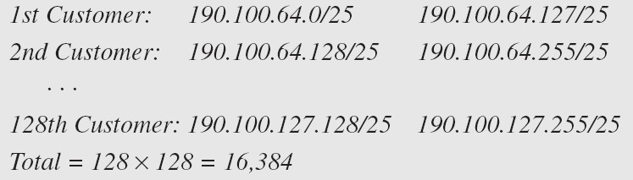
Group 2
For this group, each customer needs 128 addresses. This means that 7 (log2 128) bits are needed to define each host. The prefix length is then 32 − 7 = 25. The addresses are
Example 19.10 (continued)

Slide 22
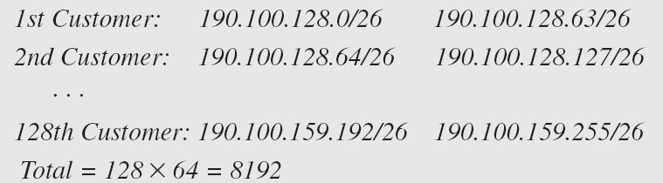
Group 3
Example 19.10 (continued)
For this group, each customer needs 64 addresses. This means that 6 (log₂64) bits are needed to each host. The prefix length is then 32 − 6 = 26. The addresses are
Number of granted addresses to the ISP: 65,536 Number of allocated addresses by the ISP: 40,960 Number of available addresses: 24,576

Slide 23
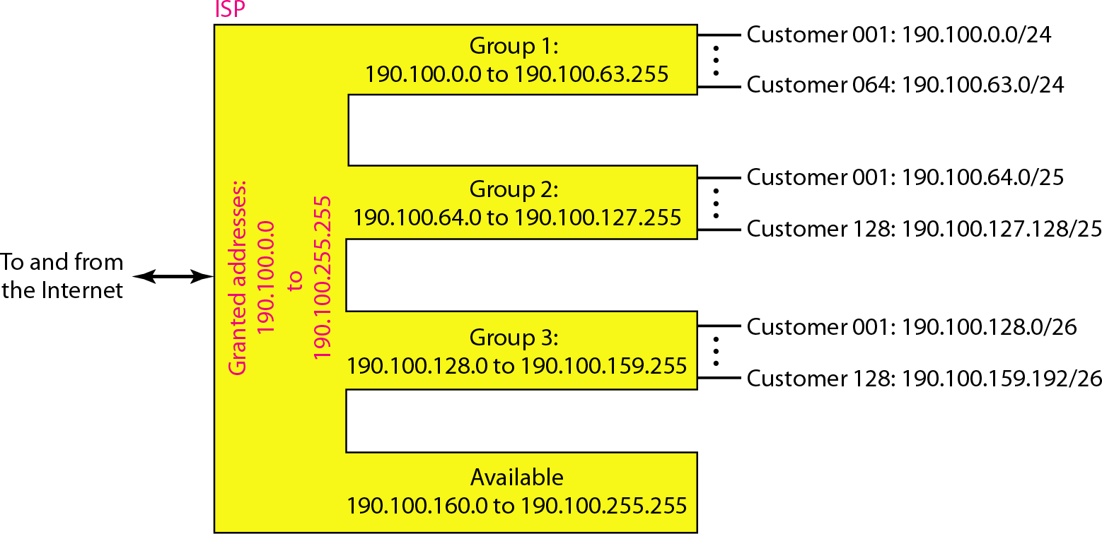
Figure 19.9 An example of address allocation and distribution by an ISP

